Slide 1
Python August 22, 2019

Slide 2
Introduction
Note that there are 2 version of Python used today, versions 2.7 and 3.*. We will be learning version 3 in this class.
A good reference guide can be found at https://www.python.org/about/gettingstarted/
For this class, it is not required to compile your HW assignments. But it will be a better learning experience if you do.
Install Python interpreter (comes with all MacOS)
Install an IDE: https://www.jetbrains.com/pycharm-edu/

Slide 3
Python Topics
What we cover this semester
Syntax
Variables & Operators
Strings
Data Structures
Conditional Expressions
Loops
Functions
Classes and Objects
Modules & Packages
File Input and Output

Slide 4
Syntax
The first useful thing to learn is how to teach computer to speak. This is done with the print statement. Output is sent to the console (or terminal or command) window, depending on how the command is executed.
print("Hello, world! My name is Jimmie”)
print(‘Hello, world! My name is Jimmie’)
print("Hello World!" + "My name is Jimmie")

Slide 5
Syntax
As we get more familiar with the Python programming language, we run into errors and exceptions. These are complaints that Python makes when it doesn’t understand what you want it to do. Everyone runs into these issues, so it is a good habit to read and understand them.
print(“Hello, world! My name is Jimmie’)
SyntaxError: EOL while scanning string literal
print(Hello, world! My name is Jimmie)
SyntaxError: invalid syntax
prit(“Hello, world! My name is Jimmie’)
NameError: name 'prit' is not defined

Slide 6
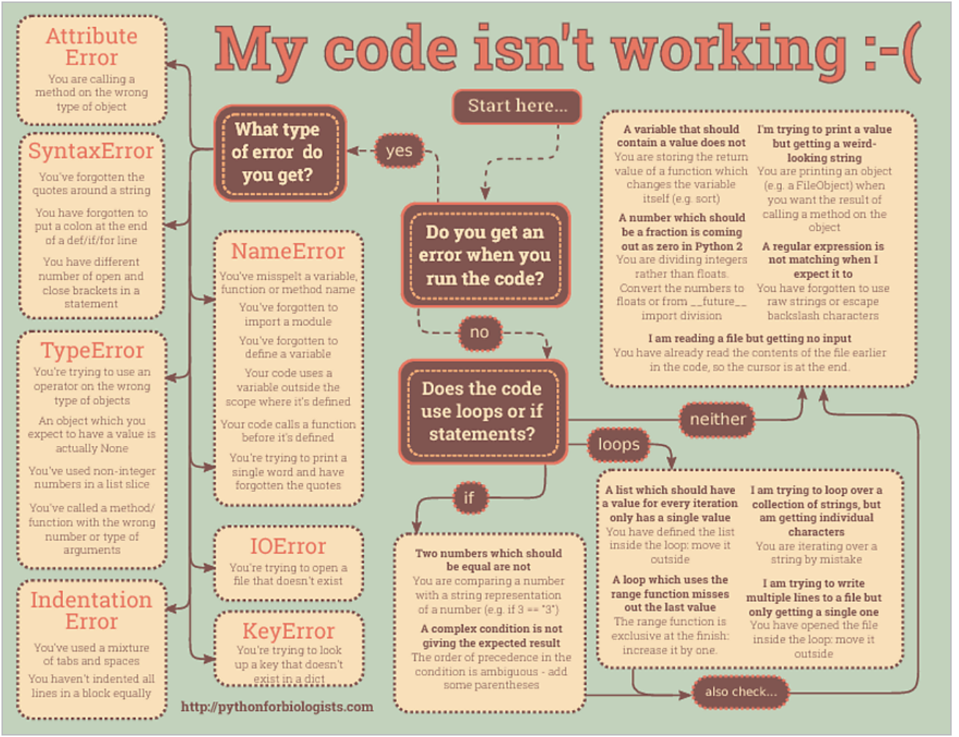
Common Errors

Slide 7
Useful Debugging Tip
If I see an error message in the terminal, how should I go about reading through it and fixing the issue that caused it?
In Python, and many other programming languages, it’s best to start with the bottom-most error message in the terminal window. Most of the time you’ll get a handful of useful information with an error message:
The line number where the issue is,
A ^ pointing to the spot where it thinks the issue may be,
An error name, like IndentationError,
And if you’re lucky, a suggestion of how to fix it!
It should be noted, though, that these are not always accurate, as the computer can only do its best to parse through code to identify issues.

Slide 8
Syntax
Comments
To insert inline comments into your code, type a # as the first character of the line. This instructs the interpreter to ignore that line.
# This is a comment in my code
Semicolons
A physical line is what you see when you write the program. A logical line is what Python sees as a single statement. Python implicitly assumes that each physical line corresponds to a logical line. Implicitly, Python encourages the use of a single statement per line which makes code more readable.
If you want to specify more than one logical line on a single physical line, then you have to explicitly specify this using a semicolon (;) which indicates the end of a logical line/statement
However, I strongly recommend that you stick to writing a maximum of a single logical line on each single physical line. The idea is that you should never use the semicolon.

Slide 9
Syntax
Indentation
Whitespace is important in Python. Actually, whitespace at the beginning of the line is important. This is called indentation. Leading whitespace (spaces and tabs) at the beginning of the logical line is used to determine the indentation level of the logical line, which in turn is used to determine the grouping of statements.
This means that statements which go together must have the same indentation. Each such set of statements is called a block.
One thing you should remember is that wrong indentation can give rise to errors
How to indent
Use four spaces for indentation. This is the official Python language recommendation.
Good editors will automatically do this for you.
Make sure you use a consistent number of spaces for indentation, otherwise your program will not run or will have unexpected behavior.

